Slide 1
Day 02
Linux Device Driver Training
Computer Networking
Presented by,
Ganavi M
Ganavigowda512@gmail.com

Slide 2
NETWORKING
Networking encompasses the design, implementation, and management of interconnected systems and devices to facilitate communication and resource sharing.
Networking involves the interconnection of devices to share resources and communicate. It encompasses both hardware (such as routers, switches, and cables) and software (such as protocols and applications).
Networking enables various activities like file sharing, internet browsing, video streaming, and remote access to resources.
It involves various technologies such as Ethernet, Wi-Fi, and cellular networks, as well as protocols like TCP/IP, HTTP, and DNS.

Slide 3
SIMPLIFIED COMMUNICATION MODEL
Sender: The device or application initiating data transmission.
Data: The information or payload being transmitted.
Protocol: The set of rules and conventions governing how data is formatted, transmitted, and received.
Medium: The physical or logical channel through which data is transmitted (e.g., Ethernet cable, Wi-Fi signal, fiber optic cable).
Error Detection and Correction: Mechanisms to detect and correct errors that may occur during transmission.
Routing: The process of directing data packets from the sender to the intended recipient across a network.
Receiver: The device or application receiving the transmitted data.
Acknowledgment: Confirmation from the receiver that the data was received successfully.

Slide 4
NETWORK MODEL
OSI Model:
The OSI (Open Systems Interconnection) model is a conceptual framework that standardizes networking protocols and divides networking functions into seven layers.
Physical Layer: Transmits raw data bits over a physical medium (e.g., cables, wireless signals). Example: Ethernet cables carry electrical signals between devices.
Data Link Layer: Provides error detection and flow control for reliable data transmission .Example: Ethernet frames include MAC addresses for device identification.
Network Layer: Routes and delivers data packets between different networks using logical addresses. Example: IP (Internet Protocol) determines the best path for data packets to reach their destination.
Transport Layer: Ensures end-to-end communication between devices and handles reliability and error recovery. Example: TCP (Transmission Control Protocol) establishes connections and ensures data delivery.
Session Layer: Establishes, maintains, and terminates connections between applications. Example: Session initiation in a video call application.

Slide 5
NETWORK MODEL
OSI Model:
The OSI (Open Systems Interconnection) model is a conceptual framework that standardizes networking protocols and divides networking functions into seven layers.
Physical Layer: Transmits raw data bits over a physical medium (e.g., cables, wireless signals). Example: Ethernet cables carry electrical signals between devices.
Data Link Layer: Provides error detection and flow control for reliable data transmission .Example: Ethernet frames include MAC addresses for device identification.
Network Layer: Routes and delivers data packets between different networks using logical addresses. Example: IP (Internet Protocol) determines the best path for data packets to reach their destination.
Transport Layer: Ensures end-to-end communication between devices and handles reliability and error recovery. Example: TCP (Transmission Control Protocol) establishes connections and ensures data delivery.
Session Layer: Establishes, maintains, and terminates connections between applications. Example: Session initiation in a video call application.

Slide 6
6. Presentation Layer: Translates data formats between different systems and handles encryption. Example: Data compression before transmission.
7. Application Layer:​ Provides user interfaces and network services to applications.​ Example: Web browsers accessing websites via HTTP (Hypertext Transfer Protocol).​
TCP/IP Model
The TCP/IP (Transmission Control Protocol/Internet Protocol) model is a practical implementation widely used for internet communication. It simplifies the model into five layers.
Application Layer: Provides network services directly to applications. Example: HTTP (Hypertext Transfer Protocol) for web browsing.
Transport Layer: Manages end-to-end communication between devices. Example: TCP (Transmission Control Protocol) ensures reliable data delivery.
Internet Layer: Handles routing of data packets between networks using IP addresses. Example: IP (Internet Protocol) forwards packets across the internet.
Link Layer: Manages communication within a single network segment. Example: Ethernet frames for local network communication.
Physical Layer: Deals with the physical transmission of data over network media. Example: Wireless signals transmitted over radio frequencies
​

Slide 7

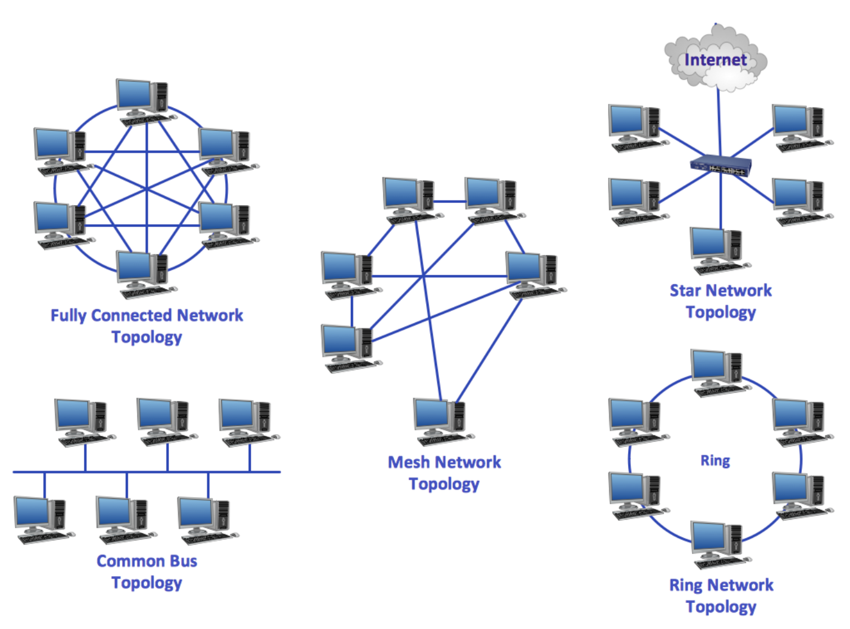
NETWORK TOPOLOGY​

Slide 8
Bus Topology: all devices are connected to a single communication line, called a bus. Data travels along the bus, and each device listens to determine if the data is intended for it. Example: A small office network may use a bus topology, where computers are connected to a central cable.
Star Topology: all devices are connected to a central hub or switch. Data travels through the hub, and only the intended recipient device receives the data. Example: Many home networks use a star topology, with devices like computers, printers, and smart TVs connected to a central Wi-Fi router.
Ring Topology: devices are connected in a circular manner, with each device connected to two neighboring devices. Data circulates around the ring until it reaches the intended recipient. Example: Some local telephone networks use a ring topology to connect different telephone exchanges.
Mesh Topology: every device is connected to every other device, creating multiple redundant paths for data transmission. This redundancy enhances reliability and fault tolerance. Example: Large-scale computer networks, such as the internet backbone, often utilize a mesh topology to ensure uninterrupted connectivity.
Fully Connected Network Topology: combines two or more basic topologies, allowing for more flexibility and scalability. Example: A large corporate network may employ a hybrid topology, with a combination of star and mesh configurations to accommodate different departments' needs.

Slide 9
PROTOCOL AND IT'S ARCHITECTURE
Protocols: Protocols are sets of rules and conventions that govern communication between devices. They define how data is formatted, transmitted, received, and interpreted. Protocols are rules and conventions for communication between devices.
Examples: TCP, IP, HTTP, FTP, SMTP.
Protocol Architecture:
OSI vs. TCP/IP: The OSI model provides a theoretical framework for networking, dividing the communication process into seven layers. In contrast, the TCP/IP model is a practical implementation widely used for internet communication, simplifying the OSI model into five layers.
Layered Approach: Protocol architecture organizes protocols into layers for modular design and interoperability.
Example: HTTP (Hypertext Transfer Protocol) is a protocol used for transmitting web pages over the internet. It operates at the application layer of the TCP/IP model.

Slide 10
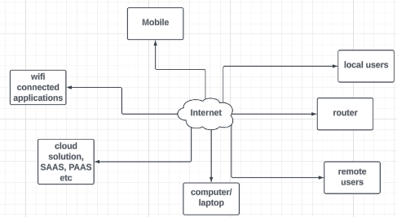
INTERNET AND HOST-TO-HOST PACKET DELIVERY
The Internet:
The internet is a global network of interconnected networks, enabling worldwide communication and information exchange. It encompasses millions of devices, servers, and networks spanning the globe.
Example: When you access a website, your request is routed through various networks and servers across the internet until it reaches the web server hosting the site.
Host-to-Host Packet Delivery:
Host-to-host packet delivery involves transmitting data packets from a source host to a destination host across a network. The process includes packetization, addressing, routing, and delivery.
Example: When you send an email to a friend, your email client breaks the message into packets, adds addressing information (such as IP addresses), and sends them over the internet to the recipient's email server.

Slide 11
DATA ENCAPSULATION
Data encapsulation is the process of adding protocol headers and trailers to data packets as they move through the OSI layers. Each layer adds its own header, allowing for modular design and protocol independence.
Key Elements:
Headers and Trailers: Additional information added to the data packet at each OSI layer, including source and destination addresses, sequence numbers, error checking codes, and protocol identifiers.
Encapsulation Process: The sequence of steps by which data is encapsulated with headers at the sender's end and decapsulated at the receiver's end as it moves through the OSI layers.
Protocol Data Unit (PDU): The unit of data at each OSI layer, such as bits, frames, packets, or segments, encapsulated with layer-specific headers and trailers.
Header Stripping: The process of removing encapsulated headers and trailers from the data packet at each OSI layer before passing it to the next layer

Slide 12
MULTIPLEXING
Multiplexing is the technique of combining multiple data streams into a single channel for transmission over a network. It allows for efficient use of network resources and increased data throughput.
Example: In time-division multiplexing (TDM), multiple data streams share the same transmission medium by taking turns to transmit data during predefined time slots.
Fundamental Issues
Reliability: Ensuring data is accurately transmitted and received without errors.
Scalability: Accommodating growth and expansion of the network without sacrificing performance.
Performance: Achieving optimal network speed, bandwidth, and responsiveness.
Security: Protecting network resources, data, and communication from unauthorized access and malicious attacks.
Manageability: Ease of network administration, configuration, monitoring, and troubleshooting.

Slide 13
NETWORK PREFIX AND HOST NUMBER
In IP addressing, the network prefix and host number together define the unique address of a device on a network. The network prefix identifies the network to which the device belongs, while the host number identifies the specific device within that network.
Key Elements:
IP Address: A numerical identifier assigned to a device on a network, typically expressed as four octets separated by periods (e.g., 192.168.1.1).
Network Prefix: The portion of the IP address that identifies the network to which the device belongs. It is determined by the subnet mask and specifies the network address range.
Host Number: The portion of the IP address that identifies the specific device within the network. It uniquely identifies each device on the network within the specified network address range.
Subnetting: Subnetting involves dividing a larger network into smaller subnetworks (subnets) to improve network performance, security, and management. It allows for efficient use of IP address space and enhances network segmentation.
Example: In a large organization, subnetting allows different departments or branches to have their own subnetworks, enabling more granular control over network traffic and security policies.

Slide 14
IP ADDRESSES AND CIDR
IP Addresses:
An IP (Internet Protocol) address is a numerical label assigned to each device connected to a computer network. It serves two main purposes: host or network identification and location addressing.
Example: An IPv4 address, such as 192.168.1.1, uniquely identifies a device on a network. An IPv6 address, such as 2001:0db8:85a3:0000:0000:8a2e:0370:7334, serves the same purpose but allows for a much larger address space.
CIDR (Classless Inter-Domain Routing):
CIDR is a method used to allocate IP addresses and IP routing in large organizations or ISPs (Internet Service Providers). It enables more flexible allocation of IP addresses by specifying the network prefix length in bits.
Example: Instead of using traditional subnet masks (e.g., 255.255.255.0), CIDR notation represents IP address ranges using a forward slash followed by the number of bits in the network prefix (e.g., 192.168.1.0/24).

Slide 15
SUBNET MASK
A subnet mask is a 32-bit binary number used in conjunction with an IP address to define the network and host portions of the address. It specifies which bits of the IP address represent the network prefix and which bits represent the host number.
Key Elements:
Binary Representation: The subnet mask is expressed as a string of 32 binary digits, with ones representing the network portion and zeros representing the host portion.
CIDR Notation: Classless Inter-Domain Routing (CIDR) notation is a compact representation of the subnet mask, expressed as a slash followed by the number of bits in the network prefix (e.g., /24).
Subnetting: Subnet masks are used in conjunction with subnetting to divide a larger network into smaller subnetworks, each with its own unique network prefix and host number assignments.
Address Allocation: The subnet mask determines the maximum number of devices that can be assigned to a network and the range of IP addresses available for host assignment within each subnet.

Slide 16
Thank you

